Slide 1
Unit 4 | Chapter 22 – Digital Data
Mr Butler

Slide 2
Learning Intentions
describe how a number is converted to a binary pattern for storage in a computer;
demonstrate understanding of the following units of data;
  Bit; Nibble; Byte; Kilobyte; Megabyte; Gigabyte; Terabyte;
demonstrate understanding of the following types of character representation:– ASCII (7-bit and 8-bit); and– Unicode;
demonstrate understanding of and use number representation and convert between denary, binary and hexadecimal;
perform the addition of two bytes and explain the meaning of overflow.

Slide 3
Let’s start with a bunch of key terms.
Bit The word bit stands for Binary digit. It is a single digit in a binary number. It will either be 0 or 1. Bits are the smallest unit of storage on a computer. All data is stored as binary.
Byte This is a group of 8 bits, which is made up of a series of 0’s and 1’s. Each byte represents a single character. The storage capacity of all computers is measured in multiples of bytes – Kilobytes, Megabytes, Gigabytes and Terabytes.
Nibble A nibble is half a byte, only consisting of 4 binary digits. It can be represented by one hexadecimal digit.
Kilobyte (KB) This is larger than a Byte. 1 Kilobyte is equal to 1024 Bytes.
Megabyte (MB) This is larger than a Kilobyte. 1 Megabyte is equal to 1024 Kilobytes or 1048576 Bytes
Gigabyte (GB) This is larger than a Megabyte. 1 Gigabyte is equal to 1024 Megabytes
Terabyte (TB) This is larger than a Gigabyte. 1 Terabyte is equal to 1024 Gigabytes or one trillion Bytes

Slide 4
Converting Numbers into Binary Patterns
Numbers in denary (base 10) allow for 10 different digits to represent numbers:
  For example, we know
And again, x10 to go to the next ‘bit’
So we know we go up x10 each time
256
Means we have
What we can do is represent this in a table format
Hint: Anything to the power of 0 is 1
6 Units
H
T
U
So two 10² = 200 +
five 10¹ = 50 +
Six 10° = 6
_________________
256
2
1
0
50 Tens
10
10
10
2
5
6
200 Hundreds
Well we have 2 of these
And 6 of these
5 of these

Slide 5
So how does this help with binary?
In binary, we don’t have 10 different digits to select from and use. We can only use two – 1 and 0.
So we need to use what is known as base 2, so this time we will draw a similar table, but this time using 2’s:
We still need to use powers, so let’s add these in again
This means that
010
2
1
0
2
2
2
Is twice the size of
001
4
2
1
So this time, our place value increases by 2 (double) each time.
Unlike in denary where it would be 10 times instead.

Slide 6



This still doesn’t answer the question of how we read a binary value?
Let’s make a visual example:
A light can be turned OFF…
… or ON
If I add a second bulb next to this:
So it has 2 possible states
How many different combinations can I have?
I can have OFF OFF
I can have ON ON
Q. How many combinations could I have for 3 bulbs?
I can have ON OFF
Or OFF ON

Slide 7
I can have 8
So If I labelled them…
0
0
0
=
0
That’s right, the combinations have doubled again.
0
0
1
=
1
0
1
0
=
2
0
1
1
=
3
0
=
4
1
0
1
0
1
=
5
But because we don’t have light bulbs in binary, we will say that when the bulb is off, we will use a 0.
And if a bulb is on, we will use 1
1
1
0
=
6
1
1
1
=
7
So we now have used just 1’s and 0’s to represent different numbers:

Slide 8
So, let’s get back to our base 2 stuff:
Let’s use a forth column (a bit like a forth light bulb)
Much like our denary, we now need to add these up:
3
2
1
0
2
2
2
2
8
4
2
1
So our binary value is 13
And let’s pick a random four bits:
1
1
0
1
8
+
4
+
0
+
1
=13
So our ‘8’ bulb is switched on:
Our ‘1’ switch is also on
As is our 4 bulb
Our 2 is switched off

Slide 9
We can make any integer using this system
Have a go at converting these binary values to decimal:
A) 10010011
B) 10101100
C) 11011100
D) 11011101
E) 10010101 + 00101100

Slide 10


Slide 11
Can we convert a denary number to binary?
So,
64 cannot be taken away from 56
Of course we can!
For example:
56
Let’s write our base 2 again
2⁶ 2⁵ 2⁴ 2³ 2² 2¹ 2⁰
⁶⁴ ³² ¹⁶ ⁸ ⁴ ² ¹
You need to see if we can take away the far left bit without going to below 0
If so, take away this from your number and write ‘1’. If not, set to ‘0’
Continue with this values and see if we can use the next base value.
32 can be
56 – 32 =
24
So we now need to see how we can make the 24 using the remaining place values
16 Can go into 24
24 – 16 = 8
So now we need to create an 8 out of the remaining bits
0
1
1
1
0
0
0
So use an 8. As 8-8 = 0, we do not need any other binary values

Slide 12
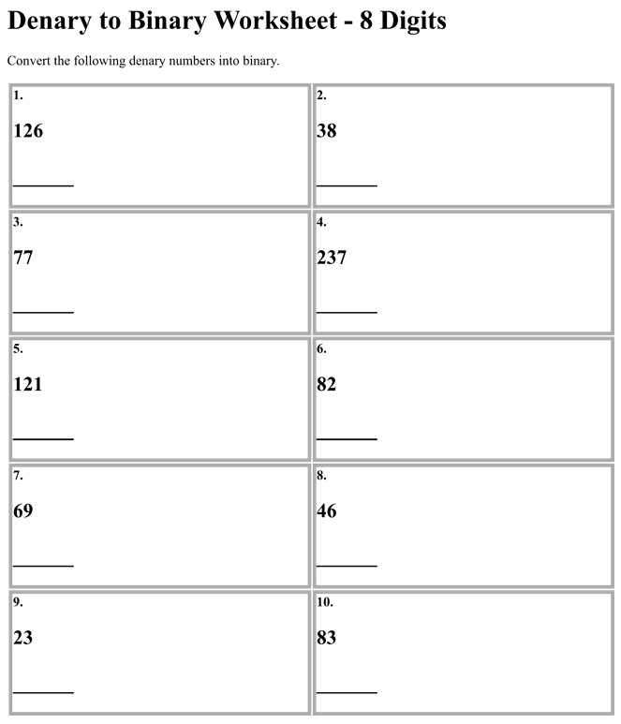

Slide 13
Binary Coded Decimal
In this form of binary representation, each decimal digit is represented by a group of four binary digits.
For example, 147 =
      1 4 7
0001
0100
0111
So 147 = 000101000111 in BCD

Slide 14
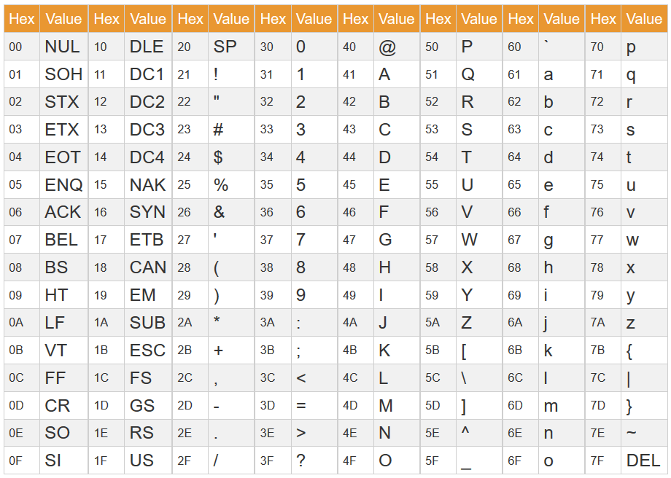
Character Sets
By definition, a character set (such as Unicode and ASCII), are a list of characters recognised by the computer hardware/software, and is represented by a number.
The first 32 characters are non-printing characters used to control hardware devices or text formatting (such as carriage returns or line feeds).

Slide 15
Representing Characters
  ASCII Code
    The original ASCII code table used 7 bits to represent text.
    This was known as the 7-bit ASCII table
    There were 128 characters in the table (2⁷ = 128)
    Each character is represented by a number. This includes numbers, letters and symbols. (i.e. ‘A’ = 65)
    8-bit ASCII table makes use of an 8th bit.
      Allows for regional characters and symbols, such as Microsoft Windows Latin-1 extended characters
      However, languages such as Japanese have 1000’s of characters and symbols, so limited to only some
      Some characters (#128-255) were used differently for different regions, so sometimes incompatibility between character sets.
      The 8th bit can alternatively be used for error checking (in the form of a parity bit)
  UNICODE
    A character encoding standard was created to resolve these issues.
    Provides a unique number for every character regardless of language
    100,000+ characters, with ASCII being a subset of Unicode
    Characters are called ‘code points’
    UFT-32, UTF-8 and UTF-16 are 3 different encoding methods
      UTF-32 uses 32 bits regardless of character. Inefficient compared to standard ASCII
      UTF-8 may use 2 bytes to represent some characters
      UTF-16 is common, making use of variable length encodings uses min 2 bytes per character

Slide 16
Representing Characters
ASCII |  | UNICODE
Pros | Cons | Pros | Cons
Only uses 1 byte to represent English Characters, which is smaller than other character sets. | Limited characters available means it cannot represent special symbols, and even with extended ASCII its character range is limited. | Can represent 65536 characters using 16 bit encoding. A lot more languages can be represented! | More bits are required to represent characters, so increases in file size.
The small character set means it is very efficient when downloading/transferring - so it’s faster to transfer. | Not scalable for global communication and is unable to represent non-English characters. | Future-proofing is present, with ability to represent emojis and other symbols being created. | More bits also increase memory requirements, often slowing down processing.

Slide 17
Hexadecimal Number System
Also known as hex.
Unlike denary (base 10) and binary (base 2), hex is base 16
Uses digits 0-9, and also letters A-F to represent data – this gives 16 possibilities
HEXADECIMAL | 0 | 1 | 2 | 3 | 4 | 5 | 6 | 7 | 8 | 9 | A | B | C | D | E | F
DECIMAL | 0 | 1 | 2 | 3 | 4 | 5 | 6 | 7 | 8 | 9 | 10 | 11 | 12 | 13 | 14 | 15
One Hex digit can be used to represent 4 bits
Computers do not work in hexadecimal but is very useful when looking at memory addresses
  Can look at a 64bit memory address as 64-bit number or the 16-digit hex pattern

Slide 18
Converting a 16-bit Binary pattern to Hex
Place values are arranged similarly to denary and binary.
Denary
10³ | 10² | 10¹ | 10⁰
1000 | 100 | 10 | 1
Binary
2³ | 2² | 2¹ | 2⁰
8 | 4 | 2 | 1
Hexadecimal
16³ | 16² | 16¹ | 16⁰
4096 | 256 | 16 | 1
We often use hex to represent colour codes on computers
  This is because we convert RGB(##,##,##) which uses two digits for each red green blue colour and store these as hex codes

Slide 19
Sign, magnitude and Complementation
The maximum unit of data that a computer can process at one time is called a word.
The size of the word is related to the computer’s architecture
  So a 16-bit processor can handle words of 16-bits at one time
Positive and negative binary patterns can be represented in a variety of different ways
  We use the left-most bit to represent the sign of the pattern
  Usually 1 = negative and 0 = positive number
Sign and magnitude is one way of doing this

Slide 20
Complementation
In a binary pattern, the left most bit is reserved for the sign and the rest of the pattern is used to represent the size of the number (the magnitude)
Let’s represent the number -7 in Binary:
Most significant bit (+/-) | 64 | 32 | 16 | 8 | 4 | 2 | 1
1 | 0 | 0 | 0 | 0 | 1 | 1 | 1
This 1 tells us it is a negative number

Slide 21
One’s Complement
When using one’s complement, each bit is inverted, so a 1 bit changes to a 0 bit and each 0 bit changes to a 1 bit
For example:
+37 in binary is 00100101
Using one’s complement: -37 is 11011010
For one’s complement using 8 bits, it is possible to represent the denary numbers -127 to +127

Slide 22
Two’s Complement
It is obtained by:
  First changing the bit pattern to one’s complement (inverting the bits)
  Then adding one to the resulting binary pattern
So, The two’s complement of +37 is:
  11011010
      1 +
  11011011 (= -37)
The left most bit tells us it is a negative number
We can now represent denary numbers -128 to +127

Slide 23
Notes:
Adding binary notes

Slide 24
Overflow
Overflow happens when computerised calculations produce an answer that is too big to be represented. Overflow usually happens during multiplication of binary. When overflow happens double length registers are used to hold the data.
A CPU with a capacity of 8 bits can only hold 11111111 in binary, if another 1 was added an overflow message would appear. The error message demonstrates that the register has exceeded its maximum number. Modern computers can now have 64-bit CPU’s which means they can handle much larger numbers.

Slide 25
Overflow
An example of an 8 bit overflow: when adding (denary 255 + 1), We would expect this answer to give us 256.
However an 8 bit overflow means that there is only room to store 8 bits and the 9th is therefore the overflow.
In the example below the 1 to the LHS (left hand side) is the overflow so the computer would say the answer is 00000000 unless it is told that it needed more room – hence the overflow bit is considered.
 | 1 | 1 | 1 | 1 | 1 | 1 | 1 | 1
+ | 0 | 0 | 0 | 0 | 0 | 0 | 0 | 1
(1) | 0 | 0 | 0 | 0 | 0 | 0 | 0 | 0
Overflow

Slide 26
Truth Tables
Computers use logical operators as well as arithmetic calculations
We can hence use AND, NOT, and OR to Boolean variables
We know a Boolean variable can only use one of two values, 1 or 0
  These can also be:
1 | 0
True | False
Yes | No
On | Off

Slide 27
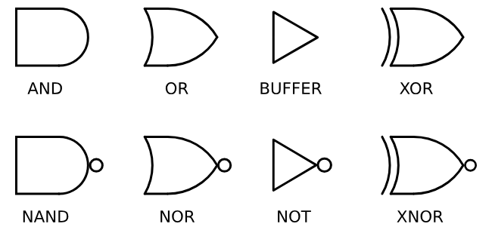
NOT Operator
The NOT operator has only one input.
X | NOT x
0 | 1
1 | 0

Slide 28
AND Operator
The AND operator can have any number of inputs
All inputs must be 1 for true to be obtained
For example, if X AND Y are > 0 THEN
x | y | x AND y
0 | 0 | 0
1 | 0 | 0
0 | 1 | 0
1 | 1 | 1

Slide 29
OR Operator
Can have any number of inputs
At least one must be true to be true.
x | y | x OR y
0 | 0 | 0
1 | 0 | 1
0 | 1 | 1
1 | 1 | 1

Slide 30
XOR Operator
Known as ‘exclusive or’
Different from OR as if only one input is true will the result be true.
x | y | x XOR y
0 | 0 | 0
1 | 0 | 1
0 | 1 | 1
1 | 1 | 0

Slide 31
There are a few notable others
Notes:
Buffer: Used to boost a weak signal
XNOR: If the inputs differ then give 0. If inputs are the same output 1

Slide 32
Using Data Types
When writing programs, we need to use data types in order to successfully store and process data.
Data used in a program can also be called variables
These variables need to be given a name and a data type and this determines how the bits representing the data are stored in memory
We use data types such as:
  Integers
  Strings
  Characters
  Date/Time values

Slide 33
